Slide 1
Data Acquisition & Wrangling Project
Somesh Sahu

Slide 2
Week 1 – Dataset 1 & Dataset 2
Tasks Done:
Loaded dataset_1.xlsx and dataset_2.xlsx
Removed unwanted columns (e.g. 'Unnamed: 0')
Filled missing values using median
Merged datasets on the instant column
Central Tendency Applied:
Mean & Median were calculated
Median used for imputation

Slide 3
Week 2 – Dataset 3
Tasks Done:
Loaded dataset_3.xlsx
Concatenated it with the previously merged data
Handled missing values again
Removed duplicates
Outlier Handling:
Outliers identified (e.g., IQR method or z-score)
Handled by removing/capping

Slide 4
Week 3 – Statistical Summary
Skewness:
Used df.skew() to find asymmetric distributions
Correlation:
Used df.corr() to check relationship between variables
Example: temperature & count, humidity & working day

Slide 5
Code Overview
Libraries Used:
pandas, numpy
Techniques Used:
Merging: pd.merge()
Concatenation: pd.concat()
Cleaning: dropna(), fillna(), drop_duplicates()
Exported to Excel: to_excel()

Slide 6
Final Dataset Snapshot
Final dataset contains rows from all 3 files
All missing values handled
Duplicates removed
Exported as: final_merged_cleaned_dataset.xlsx

Slide 7
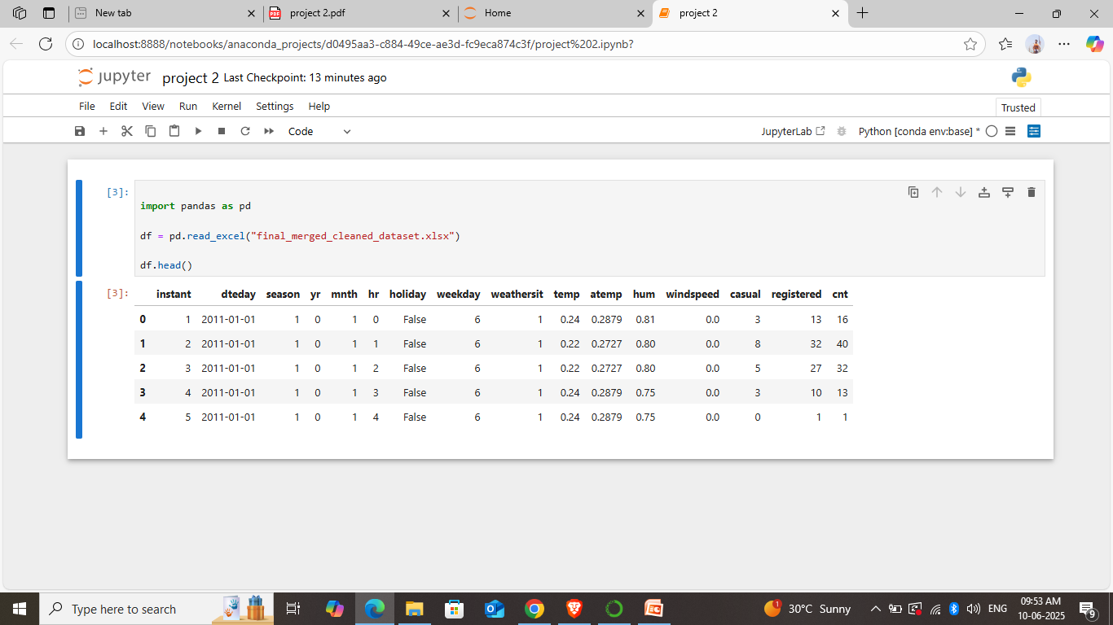
Screenshot of last few rows

Slide 8
Conclusion
Successfully completed 3-week project
Data cleaned and merged efficiently
Ready for machine learning or analysis
All objectives completed on time

Slide 9
Thank You
Submitted by: [Somesh Sahu] Date: 10 June 2025

